Slide 1

IT5182: Fundamentals of Data Models and Databases
Lecture 8
Introduction to Structured Query Language (SQL)

Slide 2
Objectives
In this chapter, you will learn:
The basic commands and functions of SQL
How to use SQL to create tables
How to use SQL for data manipulation (to add, modify, delete, and retrieve data)
How to use SQL to query a database for useful information

Slide 3
Introduction to SQL
SQL functions fit into two broad categories:
Data definition language
Data manipulation language
Basic command set has vocabulary of less than 100 words
American National Standards Institute (ANSI) prescribes a standard SQL
Several SQL dialects exist

Slide 4
Data Definition Commands
The database model
In this chapter, a database with these tables is used to illustrate commands:
CUSTOMER
INVOICE
LINE
PRODUCT
VENDOR
Focus on PRODUCT and VENDOR tables

Slide 5
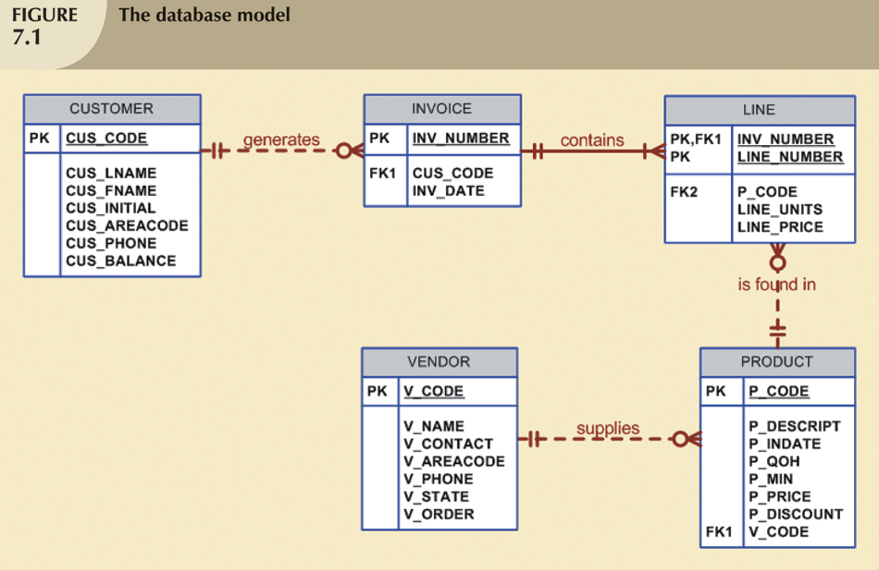

Slide 6
Creating the Database
Two tasks must be completed:
Create database using Create Database command e.g. Create Database MyDatabase
Create tables that will hold end-user data using the Create Table command.
Examples on slide 12 and 13

Slide 7
The Database Schema
Authentication
DBMS verifies that only registered users are able to access database
Log on to RDBMS using user ID and password created by database administrator
Schema
Group of database objects that are related to each other

Slide 8
Data Types
Data type selection is usually dictated by nature of data and by intended use
Supported data types:
Number(L,D), Integer, Smallint, Decimal(L,D)
Char(L), Varchar(L), Date, Time
Many other types

Slide 9
Creating Table Structures
Use one line per column (attribute) definition
Use spaces to line up attribute characteristics and constraints
Table and attribute names are often capitalised, but depends on naming convention used by an organisation – SQL does not care
NOT NULL specification
UNIQUE specification

Slide 10
Creating Table Structures (continued)
Primary key attributes must contain a NOT NULL and PRIMARY KEY specification
RDBMS will automatically enforce referential integrity for foreign keys
Command sequence ends with semicolon or GO command

Slide 11
SQL Constraints
NOT NULL constraint
Ensures that column does not accept nulls
UNIQUE constraint
Ensures that all values in column are unique
DEFAULT constraint
Assigns value to attribute when a new row is added to table

Slide 12
Example of Creating Table (using DDL) – Vendor Table
CREATE TABLE VENDOR(
V_CODE INT NOT NULL
CONSTRAINT PK_VENDOR
PRIMARY KEY,
V_NAME VARCHAR(35) NOT NULL, V_CONTACT VARCHAR(15) NOT NULL, V_AREACODE CHAR(3) NOT NULL, V_PHONE CHAR(3) NOT NULL, V_STATE CHAR(2) NOT NULL, V_ORDER CHAR(1) NOT NULL );
Notes:
12

Slide 13
Creating the Product Table
CREATE TABLE PRODUCT( P_CODE VARCHAR(10) NOT NULL
CONSTRAINT PK_PRODUCT
PRIMARY KEY, P_DESCRIPT VARCHAR(35) NOT NULL, P_INDATE DATE NOT NULL, P_ONHAND SMALLINT NOT NULL, P_MIN SMALLINT NOT NULL, P_PRICE DECIMAL(8,2) NOT NULL, P_DISCOUNT DECIMAL(4,1) NOT NULL, V_CODE INT NOT NULL
CONSTRAINT FK_PRODUCT_VENDOR FOREIGN KEY (V_CODE)
REFERENCES VENDOR (V_CODE)
)
GO
Notes:
13

Slide 14
Data Manipulation Commands
INSERT
SELECT
UPDATE
DELETE

Slide 15
Adding Table Rows
INSERT Statement
Used to enter data into table
Syntax:
INSERT INTO tablename (column1, column2…) VALUES (value1, value2, … , valueN);
Example:
INSERT INTO INVOICE (INVOICE_NUMBER, CUS_CODE, INV_DATE)
VALUES (1, ‘QW112', '7/31/08')

Slide 16
Adding Table Rows (continued)
When entering values, notice that:
Row contents are entered between parentheses
Character and date values are entered between apostrophes
Numerical entries are not enclosed in apostrophes
Attribute entries are separated by commas
A value is required for each column
Use NULL for unknown values

Slide 17
Saving Table Changes
Changes made to table contents are not physically saved on disk until:
Database is closed
Program is closed
Will permanently save any changes made to any table in the database

Slide 18
Listing Table Rows
SELECT
Used to list contents of table
Syntax:
SELECT columnlist
FROM tablename;
Columnlist represents one or more attributes, separated by commas
Asterisk can be used as wildcard character to list all attributes

Slide 19
Listing Table Rows (Continued)
SELECT statement examples:
SELECT *
FROM INVOICE;
SELECT INVOICE_NUMBER
FROM INVOICE;
SELECT INVOICE_NUMBER, CUS_CODE, INV_DATE
FROM INVOICE;

Slide 20
Summary
SQL commands can be divided into two overall categories:
Data definition language commands
Data manipulation language commands
The ANSI standard data types are supported by all RDBMS vendors in different ways
Basic data definition commands allow you to create the database and its tables

Slide 21
Summary (continued)
DML commands allow you to add, modify, and delete rows from tables
The basic DML commands:
SELECT, INSERT, UPDATE, DELETE,
SELECT statement is main data retrieval command in SQL

